Slide 1



Loan Approval Prediction
PROJECT GUIDE
Mrs.V.Saranyah
AP/AI
PROJECT MEMBER
Pradakshina.S.B
Nithish.N
Yogananth.J

Slide 2
PROBLEM STATEMENT
Detecting fraudulent loan applications is a persistent challenge. Some applicants may provide false information or engage in identity theft..
Economic conditions can impact the ability of borrowers to repay loans. During economic downturns, there may be an increase in loan defaults, affecting the overall portfolio performance.
Applicants may provide incomplete or inaccurate information on their loan applications. This can lead to incorrect assessments of their financial stability and creditworthiness.

Slide 3
OBJECTIVE
Enhance Decision-Making Efficiency:
Develop a predictive model to streamline the loan approval process, reducing the time and resources required for decision-making.
Mitigate Risk and Defaults:
Identify and assess potential risks associated with loan applications, ultimately reducing the likelihood of defaults and improving the overall health of the loan portfolio.
Enable Scalability for Future Growth:
Design the predictive model to be scalable, allowing financial institutions to handle a growing volume of loan applications efficiently and adapt to changing business needs.

Slide 4
LITERATURE SURVEY
Authors | Title of the Paper | Journal Name | Year of Publication
Sheikh Tumuluru Lohani Shaheen Sharma | Machine Learning for Loan Prediction Dataset with Data Analysis | Journal of Critical Reviews | 2021
Tejaswini Kavya Ramya Triveni Maddumala | ML Based Loan Approval Prediction System | International Journal of Innovative Research in Computer and Communication Engineering (IJIRCCE) | 2023
Ashwini S. KadamShraddha R Nikam Ankita A. Aher Gayatri V. Shelke Amar S.Chandgude | PREDICTION OF MODERNIZED LOAN APPROVAL SYSTEM BASED ON MACHINE LEARNING APPROACH | International Research Journal of Modernization in Engineering Technology and Science(irjmets) | 2022
Pallapothu Nishita Bipasha Bhowmik Poli Reddy Gayani Avantika R Sardar Puneet Prasad Singh | Loan Approval Prediction | International Journal of Advances in Engineering and Management (IJAEM) | 2023

Slide 5
EXISTING SYSTEM
The loan applications were either accepted or rejected by the system.
SVM algorithm is used for this prediction
The drawbacks are Data Bias, Data Quality, Overfittnig
Difficulty Handling Noisy Data:
SVMs are sensitive to noisy data and outliers. If the dataset contains a significant amount of noise or outliers, it can negatively impact the model's performance.

Slide 6
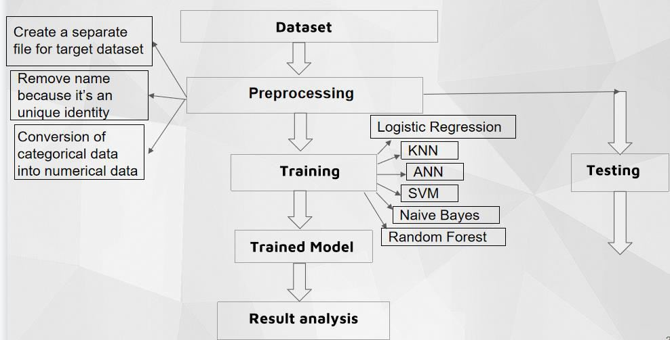
PROPOSED WORK – BLOCK DIAGRAM

Slide 7
REFERENCES
Kumar Arun, Garg Ishan, Kaur Sanmeet- Loan Approval Prediction based on Machine Learning Approach- IOSR Journal of Computer Engineering, p-ISSN: 2278-8727 PP 18-21.
Kshitiz Gautam, Arun Pratap Singh, Keshav Tyagi - Loan Prediction using Decision Tree and Random Forest- (IRJET) Volume: 07 Issue: 08 | Aug 2020.
Sujoy Barua, Divya Gavandi- Swindle: Predicting the Probability of Loan Defaults using CatBoost Algorithm- ICCMC 2021.
Bhoomi Patel, Harshal Patil, Jovita Hembram- Loan Default Forecasting using Data Mining- (INCET) Belgaum, India. Jun 2020.

Slide 8
THANK YOU

